Slide 1
Smart City
Monitor city-wide resources and consumption
Efficiently allocate resources
Allows city officials to interact directly with the community and fix problems as they arise
Notes:
ICT allows city officials to interact directly with the community and the city infrastructure and to monitor what is happening in the city, how the city is evolving, and how to enable a better quality of life.

Slide 2
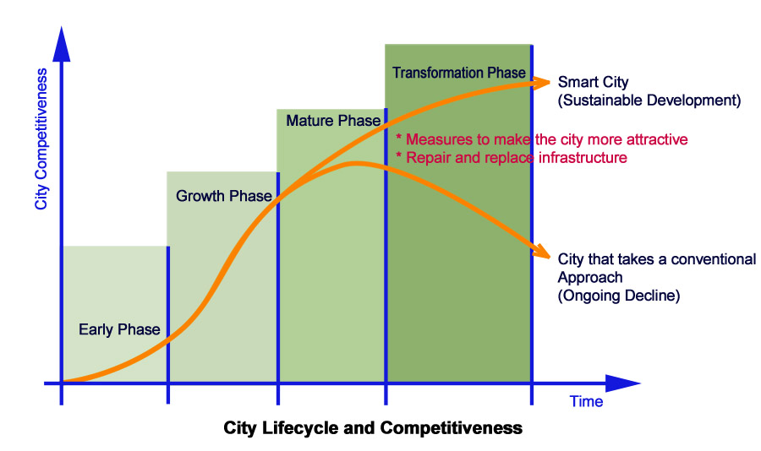
Why Smart Cities are needed now?
¹Enhancing city competitiveness - In terms of services (education ,healthcare), waste management, water management, transportation, safety etc.
Notes:
Managing the lifecycles of cities
Early phase: Provide the infrastructure needed for the operation of the city.
Growth Phase: Expand and intensify the infrastructure to ensure that supply can keep the pace with increasing demands of the growing demand.
Mature phase: Enhance infrastructure to ensure the delivery of high-quality services based on criteria such as ease-of-use and comfort.
Transformation phase: Integrate infrastructure systems to satisfy social values such as aiding, or at least avoiding damage to, the natural environment.

Slide 3
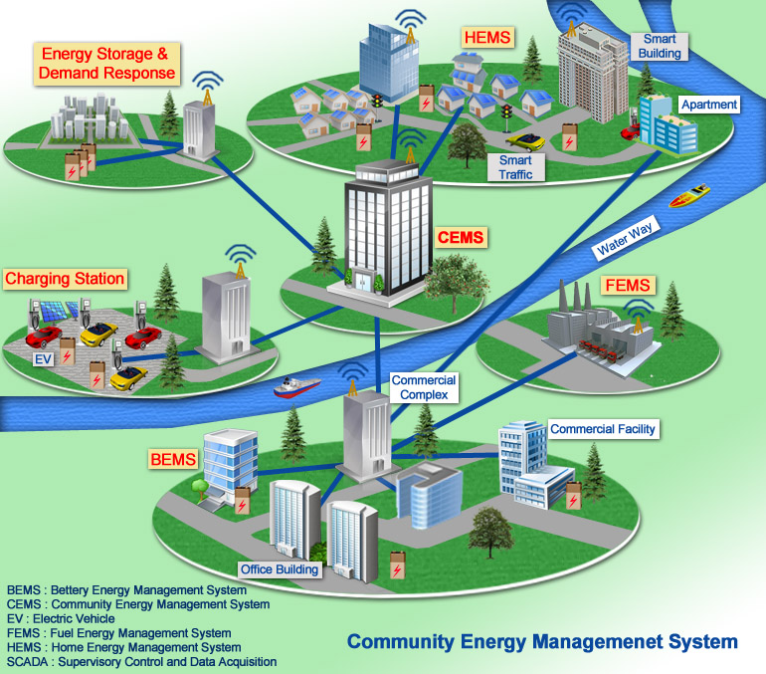
Smart City Example
Notes:
Smart Building & Home
Smart Transportation
Smart Energy (renewable generation & storage)
Smart Water Management
Smart Waste Management (recycling of waste, residual management, Recovery of waste organics & Energy)
Smart Education (e-Education)
Smart Medical Facility (e-Medical)
Smart Communications
Smart Networks

Slide 4
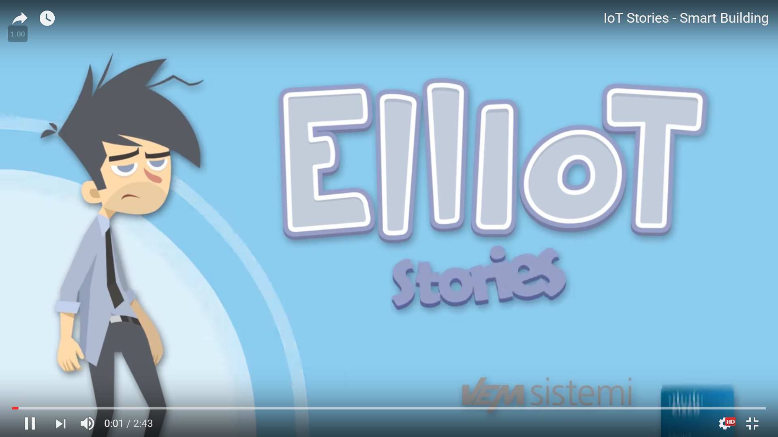

IoT Stories - Smart Building
https://www.youtube.com/watch?v=RmuEurPH9M4

